Slide 1
BacT/ALERT® 3D Field Service Engineer Training
Lesson 4 System Installation
4.1 BacT/LINK Overview
4.2 LIS & Simulator Overview
4.3 Installation Procedure
4.4 Preventative Maintenance

Slide 2
BacT/ALERT® 3D Field Service Engineer Training
Lesson 4 System Installation
Chapter 4.1 BacT/LINK Overview

Slide 3
Objectives
Discover why and how the BacT/LINK is utilized by our customers
Understand the basic principles of BacT/LINK
Know how to setup & configure BacT/LINK
Know how to test BacT/LINK connections
Know how to use the LIS Simulator Software

Slide 4
What is BacT/LINK
What does BacT/LINK provide the Customer?
Empowers BacT/ALERT system to receive data from and to transmit to the Host (LIS) System
Complies with standards as defined by the Clinical Laboratory Standard Institute, or CLIS, (originally written by the American Society for Testing and Materials or ASTM)
It is able to perform both manual and automatic communication sessions between the Host and the Instrument or DBMS

Slide 5
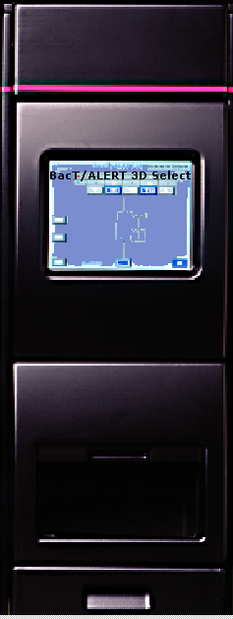
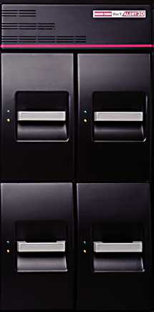

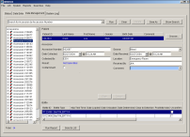


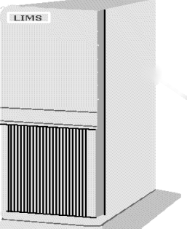
Configuration
How Does BacT/LINK appear in the Clinical situation?
SelectLinkTM
SignatureTM
L I S
L I S

Slide 6
LIS Specifications
What are the RESOURCE DOCUMENTS available to us
LIS1-A : Specification for the Transfer of Messages Between Clinical Laboratory Instruments and Computer Systems – Low Level Protocol (originally referred to as ASTM E 1381-91)
How we physically effect the transfer
LIS2-A : Standard Specifications for Transferring Information Between Clinical Instruments and Computer Systems – High Level Protocol (originally referred to as ASTM E 1394-91)
How we order our codes and what codes do we use
BacT/LINK External Specifications ( April 2003)
This is our instruction manual from bioMérieux

Slide 7


Low Level Protocol
PHYSICAL LAYER (section 5.x) – sets standards for electrical and mechanical connection between Instruments and LIS
Defines data bits – 7 or 8
Defines Parity – Even, Odd, None
Defines stop bits – 1 or 2
Sets baud rate (speed) – 1200 2400 4800 9600 (preferred)
Sets specifications for cables and connectors –
25 pin connector – pins 1 2 3 & 7 used
Sets specifications for cables and connectors –
9 pin connector – pins 1 2 3 & 5 used

Slide 8

Low Level Protocol
Data Link Layer (section 6.x) – set ground rules for communications
Information flows in one direction at a time
Replies are required after information is sent
Two systems actively operate to transfer information
Neutral state – neither system sending or receiving information
Three distinct phases for transferring information
Establishment
Transfer
Termination

Slide 9
High Level Protocol
This is the Structure of the messages, however let us make a few points about the High Level Protocol
LIS2 – A is the Document that controls, (ASTM E 1394-91)
Specifies message content for transferring information
Structures the message exchange
Provides common conventions for exchange of information
Upload – data transmitted from an instrument to the LIS
Download – data transmitted from LIS to instrument

Slide 10
LIS Message
What are some of the things you will see in a typical message?
<STX> = Start of Text Transmission character
FN = Frame Number, (0 – 7)
Text = The data content of the message
<ETB> = End of Transmission Block, (Intermediate Frames)
<ETX> = End of Text Transmission, (End Frames)
Checksum = A 2 digit number, check for message integrity
<CR> = Carriage Return, also a record delimiter, end of message

Slide 11
LIS Message
What are some of the things you will see in a typical message?
<LF> = Line Feed
<ACK> = Acknowledge last frame received, ready for next frame
<NAK> = No acknowledge of last frame, ready for resend
<EOT> = End of Text, receiver ready but request sender to stop
<ENQ> = Enquiry, ready to receive message
<Ι> = Field Delimiter, separates adjacent fields
<\> = Repeat Delimiter, separates equal parts of a field
<^> = Caret, separates unequal parts of a field

Slide 12
Message Structure
How is the typical message structured?
(H) = Header Record, is sent once at the start of the message
(P) = Patient Record, may be sent multiple times
(O) = Order Record, must be preceded by the Patient Record
(R) = Result Record, must be preceded by the Order Record
(C) = Comment Record, additional text for explanation
The LIS2-A document will set the structure of the message and the order that it must be sent and received
It is up to the LIS Vendor to set up their program correctly to the parameters as set in the LIS2-A document
Our instruments and software currently conform to the LIS2-A documents

Slide 13
Download: LIS to BTA
Three Examples:
H|\^& | | |LIS | | | | | BACT/ALERT | | P | 1 | 20021120112515<CR>
1 2 3 4 5 6 7 8 9 10 11 12 13 14
This is the Carriage Return
P | 1 | 245-13-3672 | | |SMITH^MARY | |19550401 | F | | | | |
2 3 4 5 6 7 8 9 10 11 12 13
0138^JONES | | | | | | | | | |20021101 | |ER^EMERGENCY R00M <CR>
14 15 16 17 18 19 20 21 22 23 24 25 26
O | 1 | | 923240189 |^^^BC^BSA^SAQPTF7K^5\^^^BC^BSN^SNQRD8H8^5 |
1 2 3 4 5
The Black is the Message components
The ‘Ι’, or delimiter, is the space between frames
The Red is the Field Number of the message
( Normally will not be shown in the message, shown here to identify fields )
This is the Universal
Test ID

Slide 14
Upload: BTA to LIS
Sending Results from BTA to the LIS - Four Examples:
H|\^& | | | BACT/ALERT^A.00 | | | | | | | P | 1 | 20021120112423 <CR>
1 2 3 4 5 6 7 8 9 10 11 12 13 14
P | 1 | 245-13-3672 <CR>
1 2 3
O| 1 | |923240190 | | | | | | | | | | | | | | | | | | | | | |F <CR>
1 2 3 4 5 6 7 8 9 10 11 12 13 14 15 16 17 18 19 20 21 22 23 24 25 26
R|1 |^^^BC^BSA^!AQHTDR7 |–| | | | |F | | |20021113095221 |
2 3 4 5 6 7 8 9 10 11 12
20021118095221 |1B08 <CR>
13 14
This is the Universal
Test ID
This is the Carriage Return
H = Header; P = Patient Record; O = Order Record; R = Result Record; C = Comment

Slide 15
Responsibility
Customer
BacT/ALERT 3D User Configuration settings
Cable to connect the LIS to BacT/ALERT 3D
LIS Setup Parameters
Baud Rate
Parity
Stop Bits
Data Bits
Service Engineer
Cable Information (Pin Layout)
Setup User & LIS configuration settings on system
Test the link

Slide 16
RS-232C 9 Pin Cable
Pin #
Signal
1
Receive Line Signal Data
2
Receive Data
3
Transmit Data
4
Data Terminal Ready
5
Signal Ground
6
Data Set Ready
7
Request to Send
8
Clear to Send
9
Ring Indicator

Slide 17
RS-232C 25 Pin Cable
Pin #
Signal
Pin #
Signal
1
Not Connected
14
Not Connected
2
Transmit Data
15
Not Connected
3
Receive Data
16
Not Connected
4
Request to Send
17
Not Connected
5
Clear to Send
18
Not Connected
6
Data Set Ready
19
Not Connected
7
Signal Ground
20
Data Terminal Ready
8
Receive Line Signal Data
21
Not Connected
9
Not Connected
22
Ring Indicator
10
Not Connected
23
Not Connected
11
Not Connected
24
Not Connected
12
Not Connected
25
Not Connected
13
Not Connected

Slide 18
Record LIS Message
Diagnostic Password 12123434
Select 9.0 LIS on the left column
Select Message Log
Press the Right Arrow to display the message log for the LIS
Print or save this data to a disk
Send or Fax the information

